Slide 1
Celebrity detection using AWS Rekognition
By Benjamin sklar June 2017 Cloud 230B

Slide 2
Overview
Use AWS Rekognition to build database of Celebrity-Image information (Originally did not know about recognizeCelebrity API)
Do facial analysis on images to capture faces (if any) in image; then do facial comparison with faces already in database. (Start w/ seed of faces w/ verified celebrity information.)
Website to access images and database to display information and images
Notes:
recognizeCelebrities was not in AWS CLI, turned out I need to update AWS CLI.

Slide 3
architecture
Rekognition:
APIs: indexFaces, searchFaces, getCelebrityInfo, (TODO) recognizeCelebrity
face-collection (stores face meta-data): brsklar-celebrity-images (so full image analysis is not needed to compare faces in collection)
S3 bucket: benjaminsklar-celebrity-images (for image file storage and website files)
DynamoDB tables:
CelebrityImageFiles: filename, image type, height&width, source, imageid from indexFaces call
CelebrityFaces: face data including source file, face meta-data, id into face-collection brsklar-celebrity-images.
CelebrityFaceMatches: many-many face-id pairs with Similarity value
Lambda functions
trigCelebrityImageFiles: on insert into CelebrityImageFaces, calls indexFaces, and places data in CelebrityFaces
trigCelebrityFaces: on insert into CelebrityFaces, calls searchFaces, and places data in CelebrityFaceMatches
Supporting functionality: IAM roles, Cognito for website access

Slide 4








Amazon Cognito
Benjaminsklar-celebrity-images
CelebrityImageFiles
trigCelebrityImages
CelebrityFaces
trigCelebrityFaces
CelebrityFaceMatches
Amazon Rekognition
Notes:
Used icons from: https://aws.amazon.com/architecture/icons/
Website files use Javascript to access DynamoDB tables to build dynamic pages. Names.html also uses Rekognition getCelebrityInfo

Slide 5
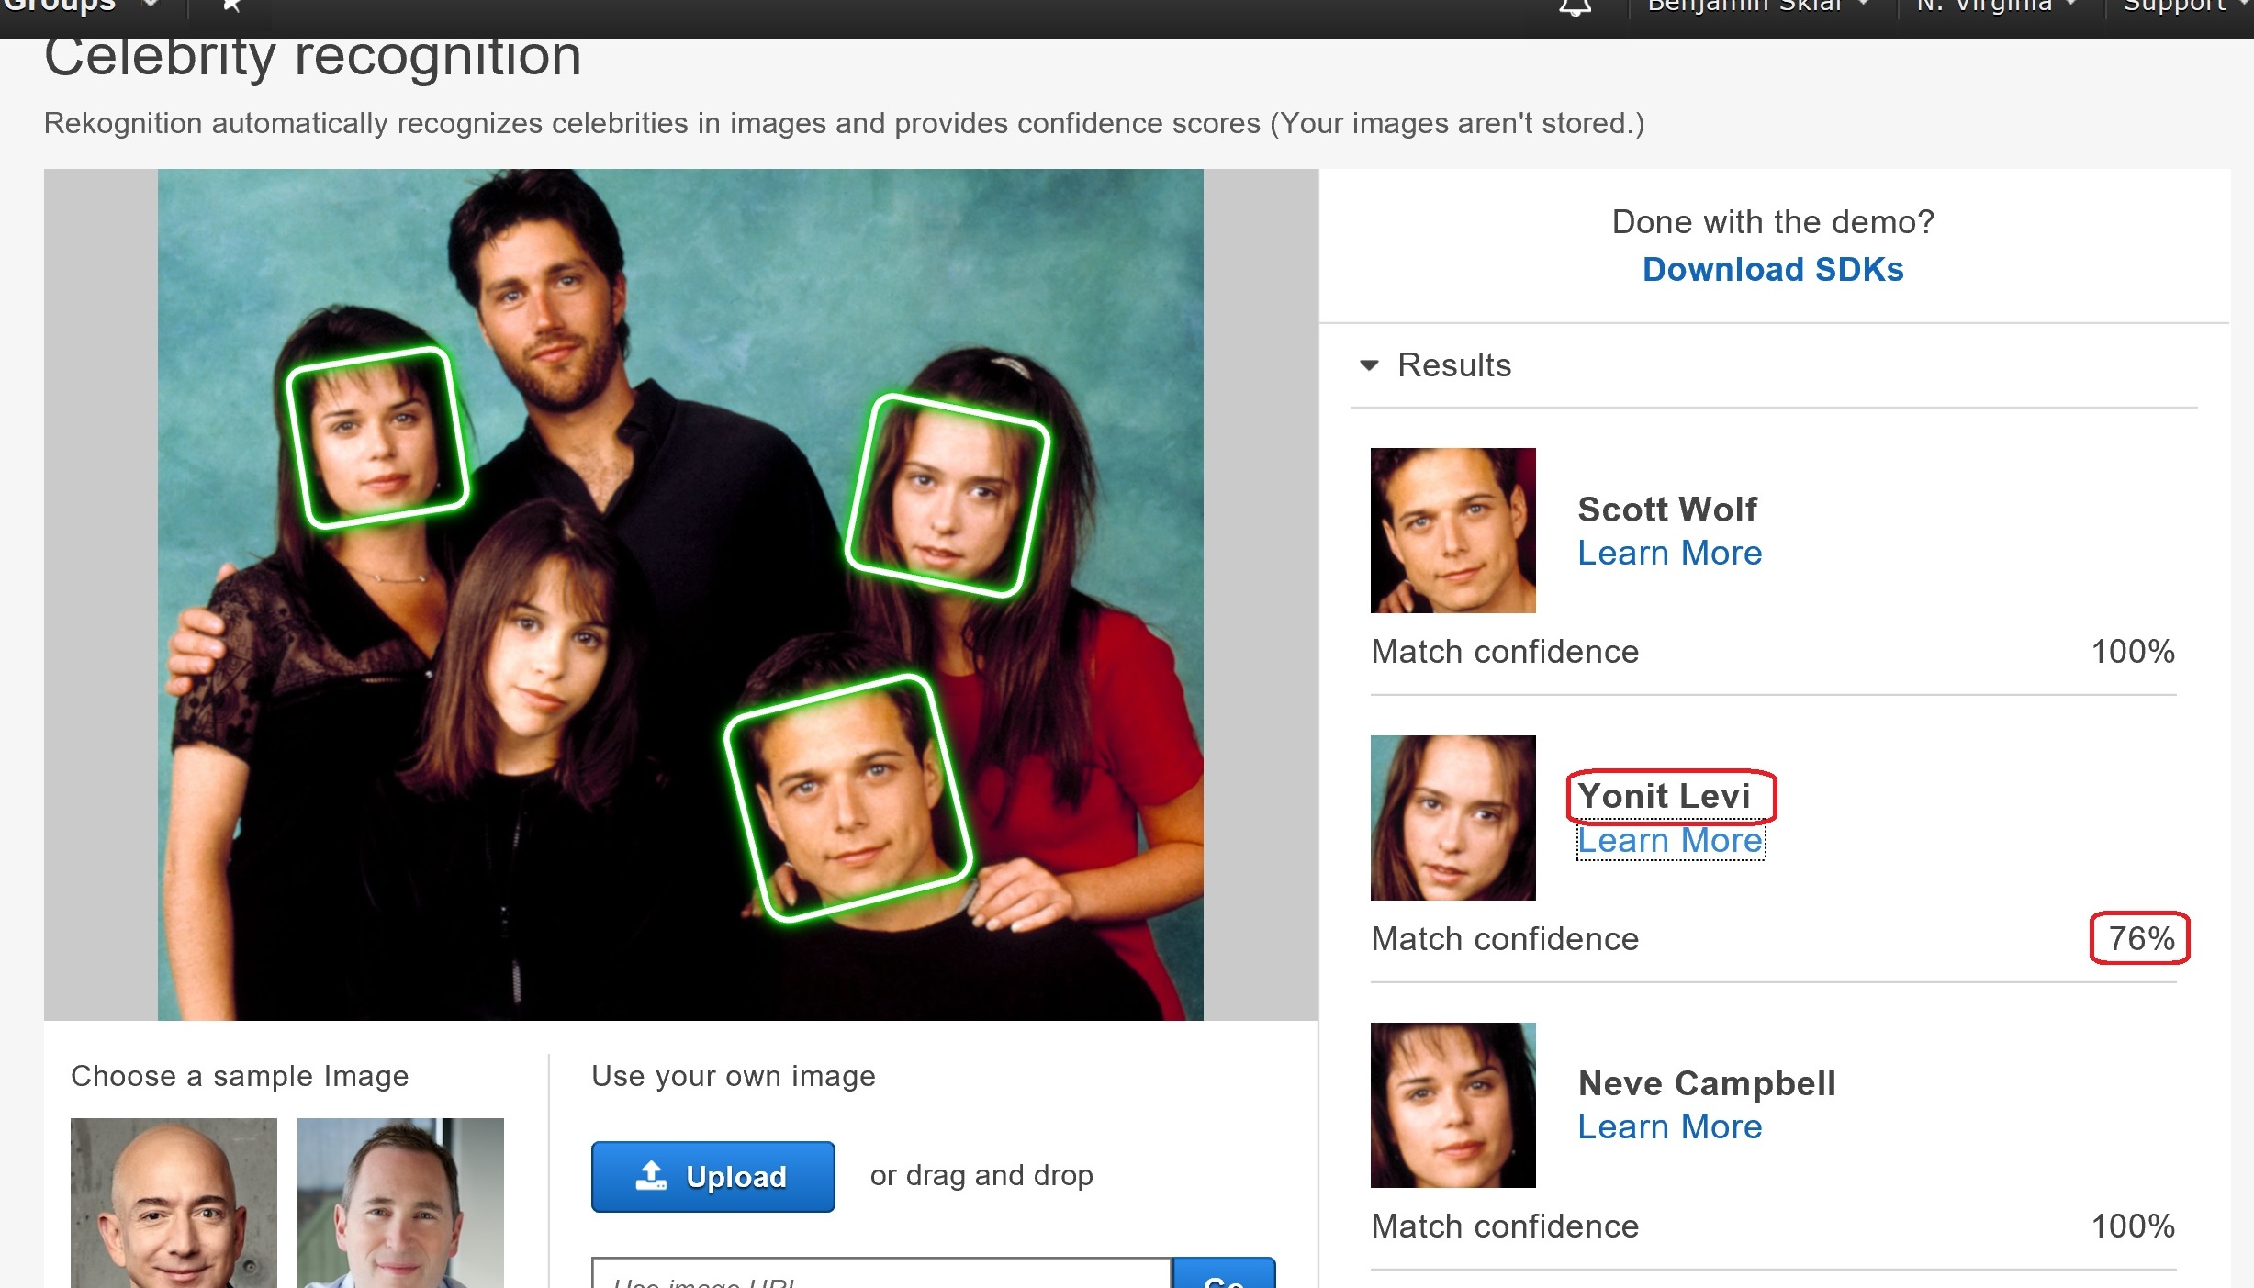
Rekognition Celebrity recogntion
recognizeCelebrities API does facial recognition and compares faces with AWS’s celebrity face-collection (provides Name and imdb.com url)
Notes:
“Party of Five” from 1994 – 2000. Image approximately season 2 or 3.

Slide 6
ToDO
Make use of Rekognition API recognizeCelebrities in lambda function trigCelebrityImageFiles
Write API Gateway & Lambda function to upload new images; Take URL or local file, validate as JPG or PNG image, detect height & width, upload to S3 bucket, and put new entry into CelebrityImageFiles table. (Write webpage to use this)
On website show bounding boxes where appropriate
Combine webpages allimages.html and image.html into files.html
Clean and style webpages
Limit IAM roles to least-privilege-needed

Slide 7
Links
Website: http://benjaminsklar-celebrity-images.s3-website-us-east-1.amazonaws.com
Source: https://github.com/brskl/Cloud230B_final
AWS Documentation: https://aws.amazon.com/rekognition/
Competition:
https://azure.microsoft.com/en-us/services/cognitive-services/face/
https://cloud.google.com/vision/
Notes:
Azure facial analysis results seem to be better (includes hair)
Google results a bit disorganized but did provide URLs of similar images

